Slide 1
Bio 5984
Quantitative methods in ecology and evolution

Slide 2
About me
Hi, I’m Kate, and I’m a biologist.
This is not a class in math or statistics, and there are better courses to find all the “why” details.
This is a class to offer some applied skills that (I hope) will help students explore more complicated statistical and mathematical concepts, either independently or through more specialized coursework.
The course focus is on actually doing stuff, particularly on how to do it in R. We aren’t going to spend a lot of time on the details of any particular type of model, but instead help to build the dichotomous tree of types of analyses one might use, and how to actually implement them in R.
The course will be organized in the way that one actually interfaces with their data, so for the first few weeks we will be mainly talking about data wrangling and visualization.

Slide 3
Send me a message on Canvas with…
Name, email, pronouns
Advisor and Dept
Likely thesis topic
Do you have a dataset?
Please provide a one-sentence description of this.
What is your enrollment status in this course? (e.g. enrolled A-F, enrolled audit, enrolled P/F)
Please provide a previous description of your R experience.

Slide 4
Poll everywhere
Please navigate to this page to anonymously describe your experiences with R and statistics
Respond at: PollEv.com/katelangwig411
Notes:
Kate! Login to https://www.polleverywhere.com/surveys/LeG3iNudDKXmiXo9hC9oR. Enter standard password. Need to activate poll.

Slide 5
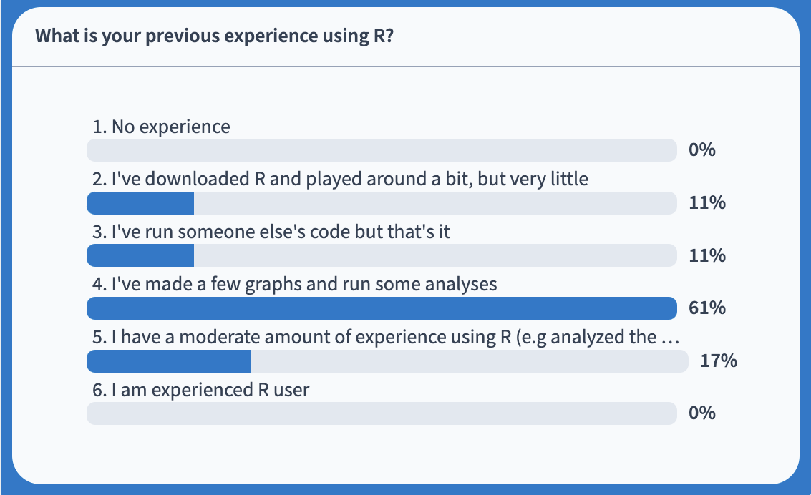
R experience

Slide 6
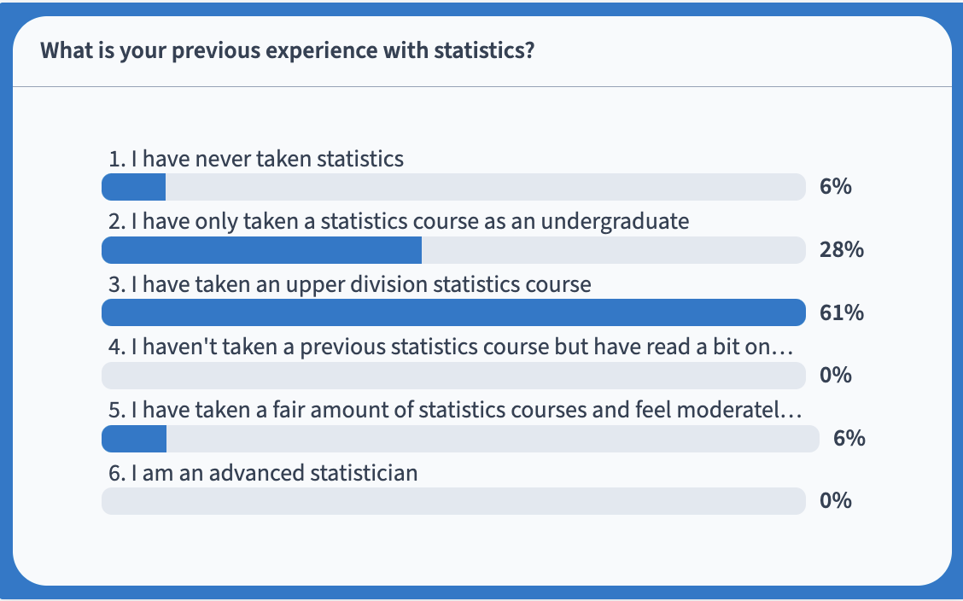
Statistics

Slide 7
Diverse learners
This class is likely to have a diversity of learners with different experiences
It’s important to remember that something that is boring to one person might be extremely challenging to another
Things I’ll try to do:
Provide assignments with additional opportunities for advanced learners to keep everyone challenged
Teach at a pace and level that doesn’t lose beginners while emphasizing tips and tricks that even the most advanced learners might learn something new
Provide feedback on your thesis project (statistical, visualization, clarity, content) – hopefully helpful regardless of your skill level
Things you can do:
Help each other!
Don’t just do the minimum – make an effort. Use this as an opportunity to work on your thesis!
Set goals that will help to advance your thesis and make me aware of these goals so I can help to foster them.
New this year – official 1 assignment waiver for providing 1 hr of help to another student (upload photo or short description with the name of the assignment).

Slide 8
Providing feedback
Early, always and whenever you are frustrated.
We won’t be able to cover everything you want to learn, so please mention other things you’d like to learn early! I can try to integrate them into existing lectures.
Less helpful:
Anonymously, after the class has ended. ☺

Slide 9
Regardless of your current abilities, you are my favorite student!

Slide 10
Preparation
Bring your laptop
Install (or update) R
Open source via the Comprehensive R Archive Network - https://cran.r-project.org
Link is at the top of the page
Also, install Rstudio (now called Posit)
You want the desktop version
https://www.rstudio.com/products/rstudio/

Slide 11
Where to find info about the course:
https://github.com/VTQuantMethodsEEB/klangwig
Look at README
This will have more information than Canvas! Canvas files may be out of date compared to this folder.
When we learn about GitHub next week, you could add this folder directly and pull to get updates.

Slide 12
Class structure
Tuesdays
Lecture
Thursdays
Working lab
Assignments will typically be given on Thursdays, and due by midnight on the following Wednesday.
Most important: Code should be reproducible.
Email me if you need more time, participation is 10% of your grade. See late policy in syllabus.
Don’t agonize over these.

Slide 13
Data
The goal of this course is teach you useful skills for exploring your own data.
The best scenario is you use actual data from your thesis.
Also acceptable: borrow a dataset that will be similar to your thesis dataset, ask your advisor – they may be thrilled to share something from their file cabinet.
Online repositories are also great places to get data! Please let me know ASAP if you do not have any dataset or have any way of obtaining one so we can brainstorm some solutions.

Slide 14
Before we get into R…
In recent years, I’ve come to understand that knowledge of computers has changed!
I grew up in this generation:

Slide 15
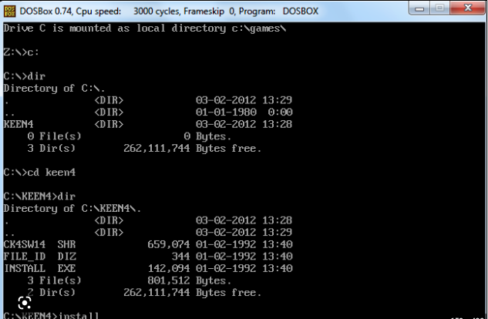
To play this exciting game, we needed to do something like this:

Slide 16

Now…

Slide 17
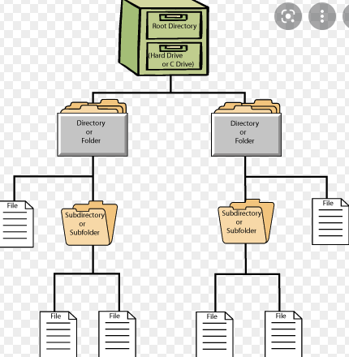
If you played Oregon Trail, the next part might be stuff you know, but here is a bit of a refresher…
Computers are organized into hierarchical structures
Files live in folders
Folders live in more folders that are located on hard drives (e.g. C: for a PC)

Slide 18
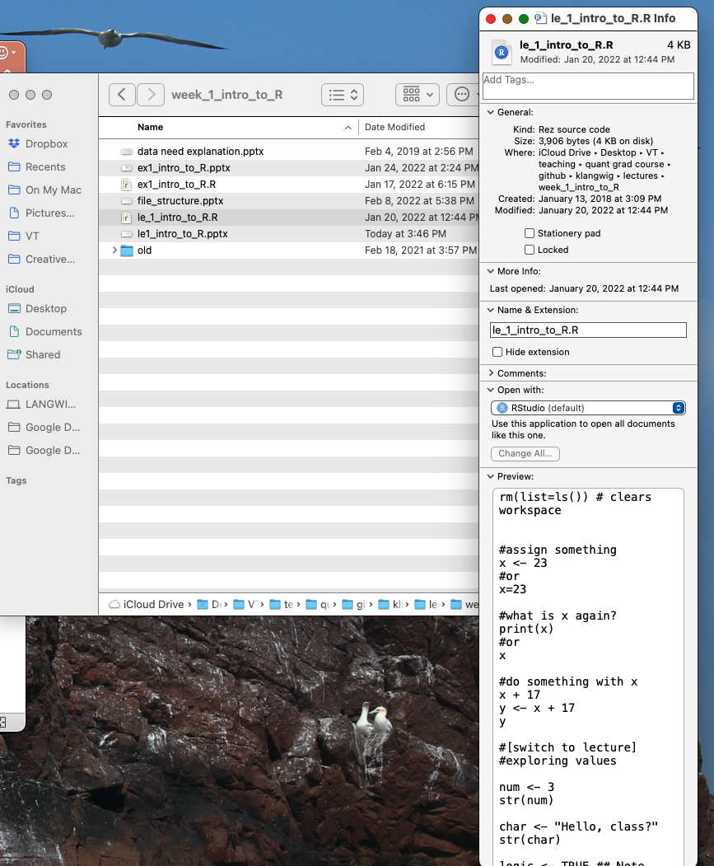
How to find where your files are
New computers make it hard to figure out where your files live
To figure this out right click, and choose get info or properties
This is extremely important for working in R and GitHub because you need to tell the computer and Git where to find files

Slide 19
What is R?
R is a programming language.
It’s open-source, which means any of us could write an contribute packages for R.
This is both awesome and terrible.
What are some of the pros and cons of this?

Slide 20
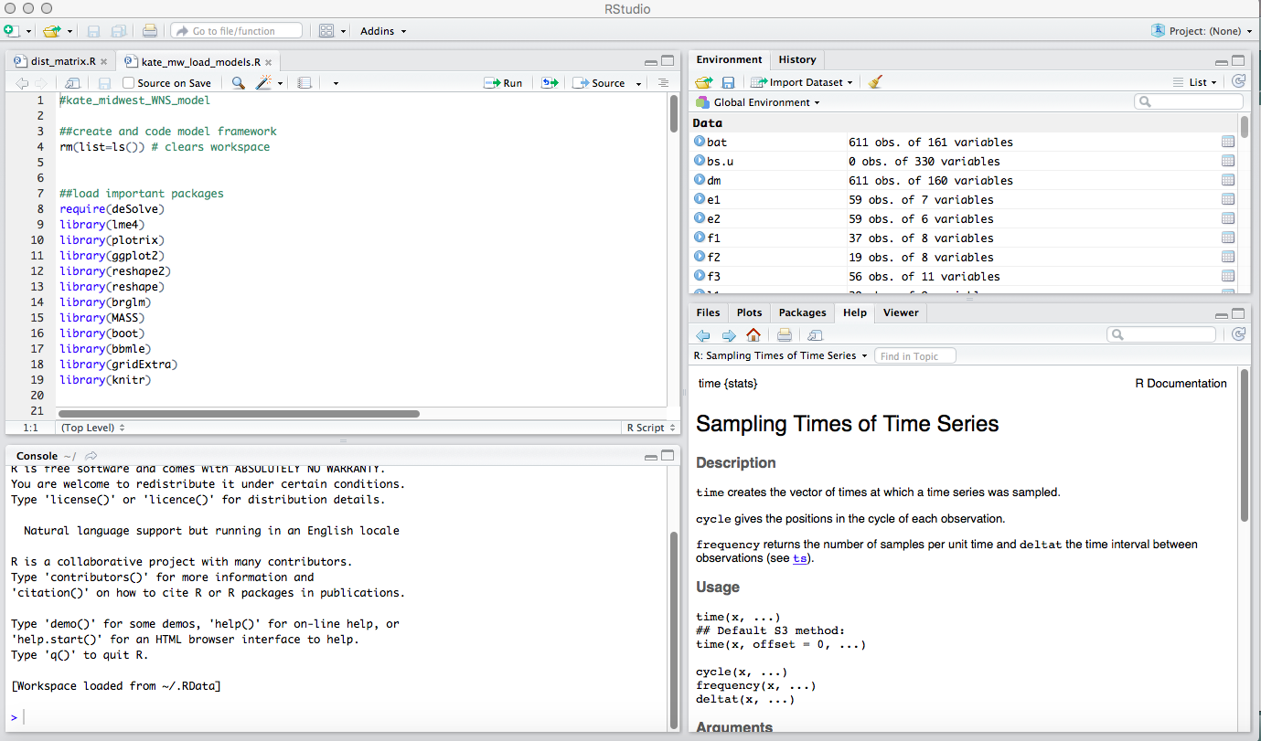
Exploring R
Write your commands here (command + enter) to run

Slide 21
Exploring R
They will be executed here, in the console.
You can also enter stuff directly into the console. (enter to run, esc to quit)

Slide 22
Exploring R
R studio tells you what is currently loaded here

Slide 23
Exploring R
This window is where you visualize most things, also help window

Slide 24
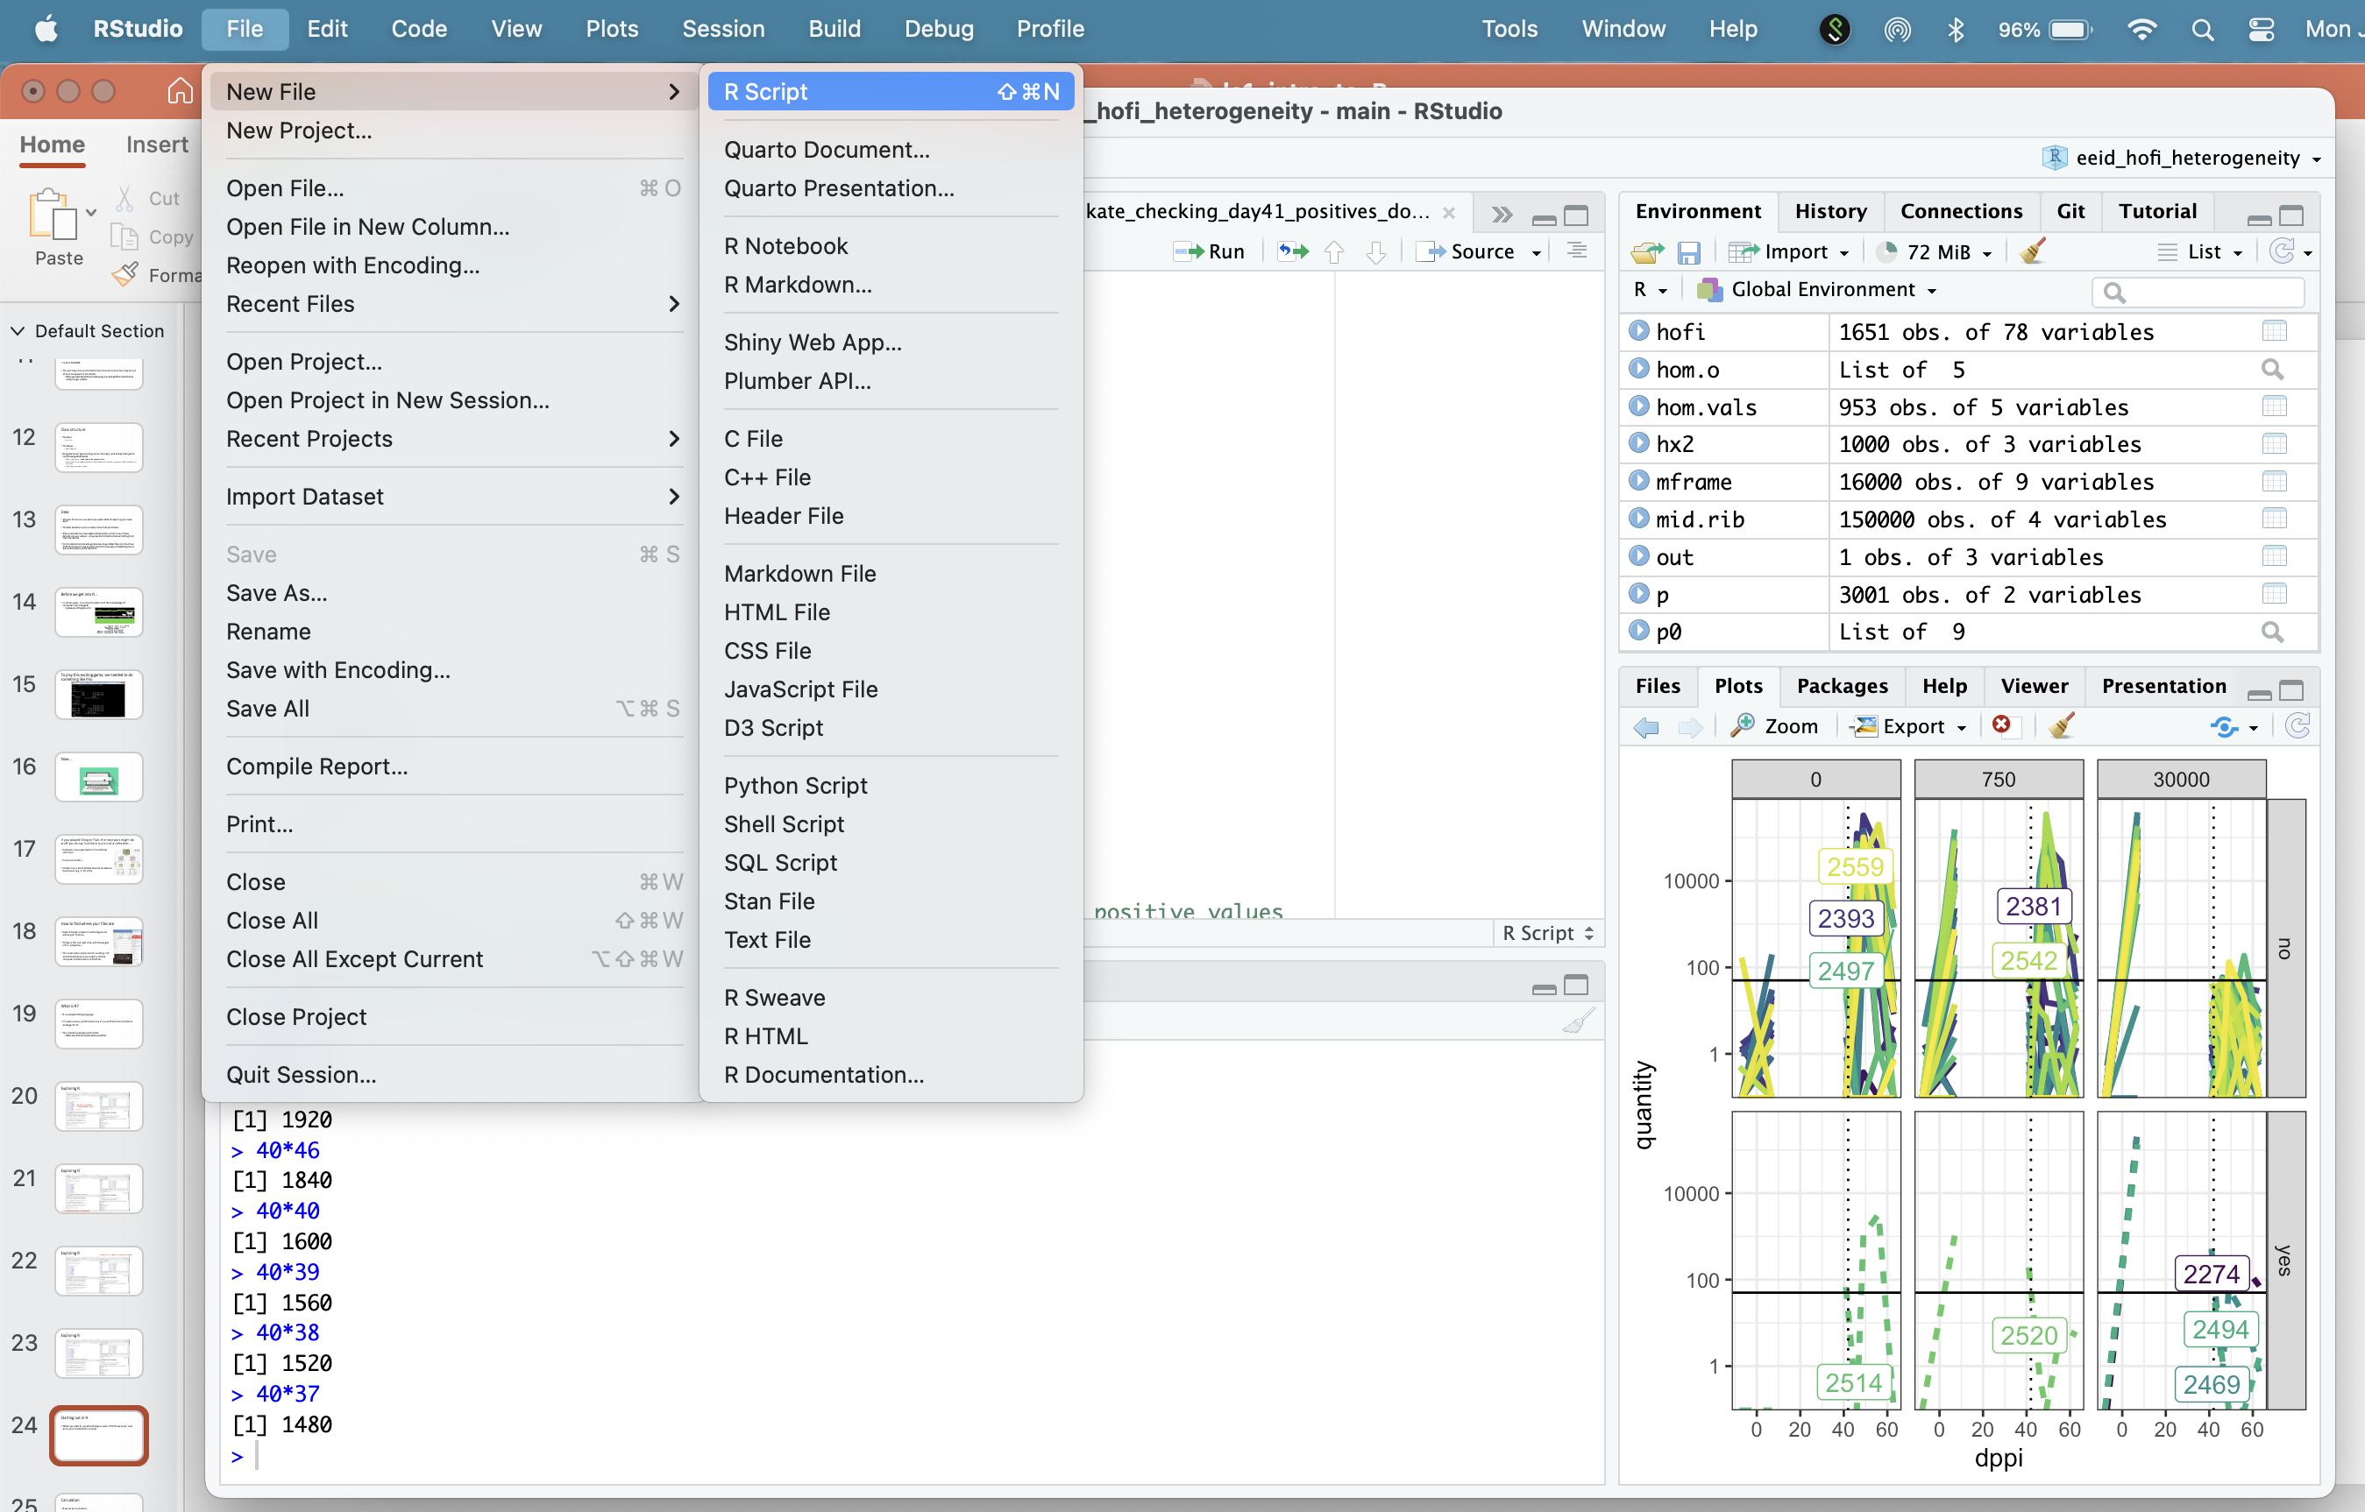
Starting out in R
When you start R, you should always select ‘File→new script’ and write your commands in a script
Do not type directly into the console unless it is something you don’t care about saving

Slide 25
Saving scripts
When you save script files, you should only save the .R files.
You DO NOT need to save the workspace
You should save .R scripts with a sensible name
e.g. all of mine start with langwig_introR_week1.R
They should also be stored in appropriate folders (more on this later)
Specifically your folder will be associated with a github repository and an .Rproj file

Slide 26
What can R do?

Slide 27
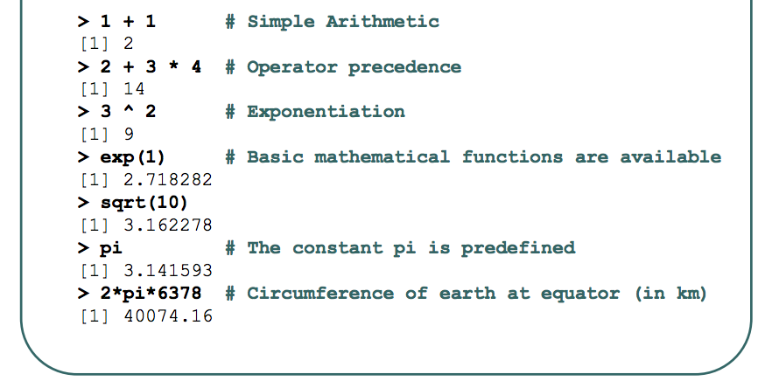
Calculation
Very simple: R works as a calculator

Slide 28
Assigning things in R
<- vs. =
Both assign things in R, but some people think the “=“ is sloppy coding
I also use <- when writing functions
(switch to R console)

Slide 29
Objects in R
R keeps track of a variety of objects and functions
You can see all of your user-defined objects by typing objects() (the parentheses mean that you are calling a function; more on this later).
This should also be what is listed in the environment (top right)

Slide 30
Values
In addition to numbers, R has other kinds of values (also known as “atomic types”).
The main ones we’re interested in are character, numeric, factor and logical (ie., TRUE or FALSE). str() is one way to try to figure out what your R object is.
Eg. str(x)
When you read in data, R automatically assigns your field a value type. Sometimes, this value type is wrong. You can often convert among data types with new.x <- as.numeric(x) but BE CAREFUL!

Slide 31
Factors
Factors are used to describe items that can have a known set of values (gender, social class, etc.) - categorical variables in statistical terms.
When you read data into R, many variables containing text will be automatically stored as factors
This is helpful for analyses, but can be kind of annoying if you want to make a change in your data
(Switch to console)

Slide 32
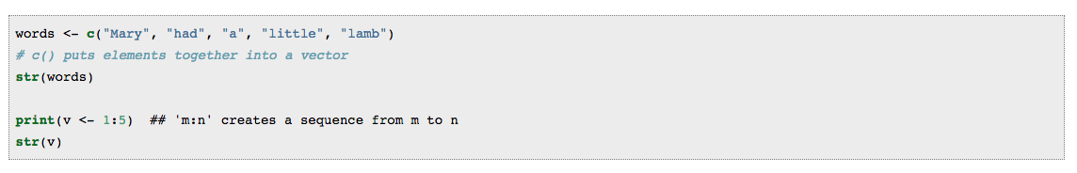
Vectors, lists, and functions
A vector consists of zero or more values of the same storage mode:
R uses vectors very efficiently – these are typically the data types that R works fastest with.

Slide 33
Vector math
R does math on vectors directly.
If we add (for example) two vectors we add each pair of corresponding elements.
If we multiply a vector by a scalar (a single number) we multiply each element by the scalar.
Avoid arithmetic involving two vectors of different length (except the scalar case, above)
Switch to console

Slide 34
Lists
A list is a bunch of things in order. Those things can be any R object - vectors, functions, other lists …
If you have ran a regression in R, the output is a list
Lists are annoying to deal with because each element needs to be extracted to work with
There are ways to convert lists to other data types, but it usually involves some annoying coding to change column names, or remove row names

Slide 35
Functions
Functions are “called” using parentheses. A function is a set of commands that uses whatever “arguments” are inside the parentheses and does things (including possibly “returning” a result).
Functions (often written by others) are the fundamental backbone of the R environment. They will let us do most of the things we want to in R.
Many functions are part of the base environment – e.g. they come pre-installed with R
Others are part of packages that are installed separately. Some of these packages are particularly useful for ecologists, and we will be using these instead of the base R packages (e.g. ggplot2 instead of plot).

Slide 36
Function examples
Example: mean() in its simplest form takes a vector argument and returns the mean.

Slide 37
Getting help on functions
You can learn about any built-in function by using R’s help:
type ?"mean" or help("mean").
Arguments can be passed to functions in order, or by using names. For example, mean takes an optional argument trim.
A major complaint about R is that help pages can be indecipherable, especially for beginners.
Quick-R often has more helpful information when you are just starting:
https://www.statmethods.net/index.html
(switch to console)

Slide 38
Variable names
R variable names are case-sensitive. This means that m and M are different variables. In general, you should not try to take advantage of this, because it may cause confusion.
R variable names have to start with a letter, and certain characters (particularly space characters) are not allowed. Good naming conventions include:
Using mostly letters, underscores (_) and dots (.)
Not using potentially confusing names like l or O.
Not using built-in names (like c, list, or data) for variables.
Make readable variable names using camelCase, snake_case, or kebab.case
Avoid variableNamesThatAreExcessivelyLong

Slide 39
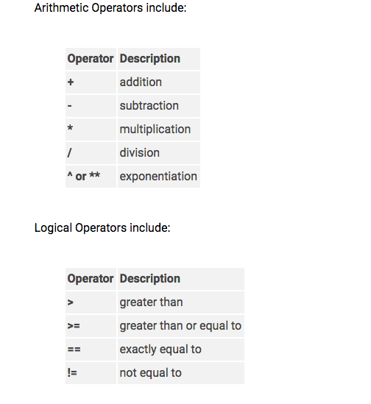
Operators

Slide 40
Matrices vs Data frames
In R, matrices are basically vectors that understand that they have a shape. R knows how to do matrix multiplication on them. There are many ways to make a matrix: use ?"matrix" to get more information.
Data frames are lists that have a rectangular shape (they look like, and can be used a like matrices, but don’t have to be of a single “mode” - in particular you can mix numbers, factors (see below), dates, …).
These are primarily what you will use in R when working with your own data
(Much more on this later)

Slide 41
Referring to a column in a data frame
$ (the dollar sign) is used to refer to a column within a data frame
(switch to console - #dataframes)

Slide 42
Selecting
There are multiple ways to select items in R
The original way is that you can select items using [] (square brackets)
Try an example using a built in dataset (InsectSprays)

Slide 43
Dates
Working with dates can be a bit frustrating because as time units get larger, they become more variable. For example, at what day does the 75th percentile of the month fall?
An important note – macs and windows machines often handle dates differently and the default is different in excel.
One a mac the default is mo/day/two digit year – e.g. 01/13/18 is January 13, 2018, but on a PC the default is “01/13/2018”. This can result in some frustration between people sharing scripts!
Typically, dates will be loaded in as characters. If you want them to be dates, you need to tell R this.

Slide 44
Working with data in R
Save files as .csv
IMPORTANT – saving an excel file as a CSV means that you will lose some data
For example, if you used excel to calculate a formula, the formula will be gone as R will just store this as plain text
DON’T USE EXCEL TO DO CALCULATIONS – JUST ADD THIS TO YOUR CODE IN R
Use smart column names. R can’t handle spaces in your column names, so get rid of those. Also don’t use a bunch of capitals unnecessarily because it slows down your coding.
e.g. use “species” not “Species”
There are packages that allow you to read in .xls files (gdata in JD), but I think using .csv is easier

Slide 45
Making your excel file
Excel files should have a list of column names at the top only and variable values
Your excel file should not look like your field data sheet

Slide 46
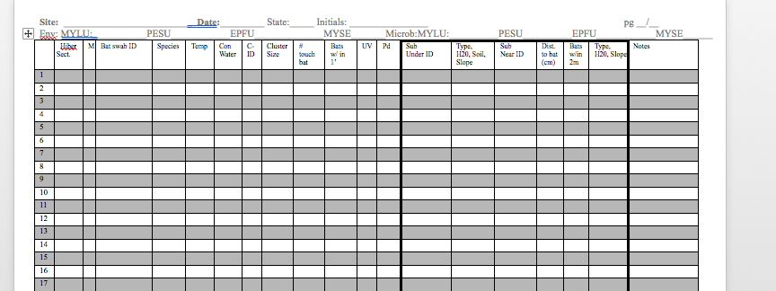
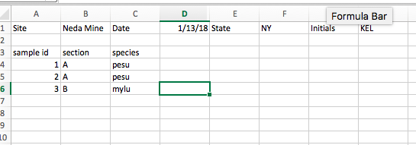
What is wrong with this excel entry?

Slide 47
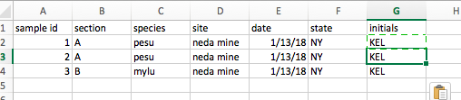
Excel corrected

Slide 48
STOPPED HERE

Slide 49
Spaces, special characters, commas, etc
Do not use:
;
,
-
“ “ (space)
#
*
~

Slide 50
Things R recognizes as different, but you might not:
Imagine you have a column called ‘species’ in your dataset:
‘maple’
‘Maple’
‘MAPLE’
‘ MAPLE’
‘MAPLE ‘
‘ maple’
‘mapel’
Fix these in excel! Start now. The best way to do this is using the ‘filter’ functions in excel.

Slide 51
Missing data
Ecologists often have a bunch of missing data (e.g. a frog got loose and you didn’t get a weight, you ran out of bands, etc.)
R understands NA (all caps) and usually blank cells.
Sometimes if you re-use a spreadsheet template, R thinks there are a bunch of blank cells at the bottom of the file.
Sometimes if you have typed values in cells, or formatted them funny, R thinks these cells are empty
You can always find and replace in excel
You can also tell R how to deal with missing values when you read in data

Slide 52
Overview of file organization for course
You will have a folder on your computer that will ALL the files associated with this course (data files, documents, R scripts).
This folder may have subfolders which you should denote in your scripts
This folder will be associated with an R project file and a Github repository (e.g. folder)

Slide 53
Reading data
r2 <- read.csv("/Users/klangwig/Dropbox/Contact rate MS/Network graph/Network data/enviro_master.csv")
Replace with your own directory (can check with right click and “get info”)

Slide 54
Creating a project
Creating project allows for directory free reading of files and is more generalizable across users
This will also allow us to better synchronize and share code
A project is associated with a folder on your computer. The folder can contain sub-folders. Next week, we will learn how to use Git to work on projects using version control.

Slide 55
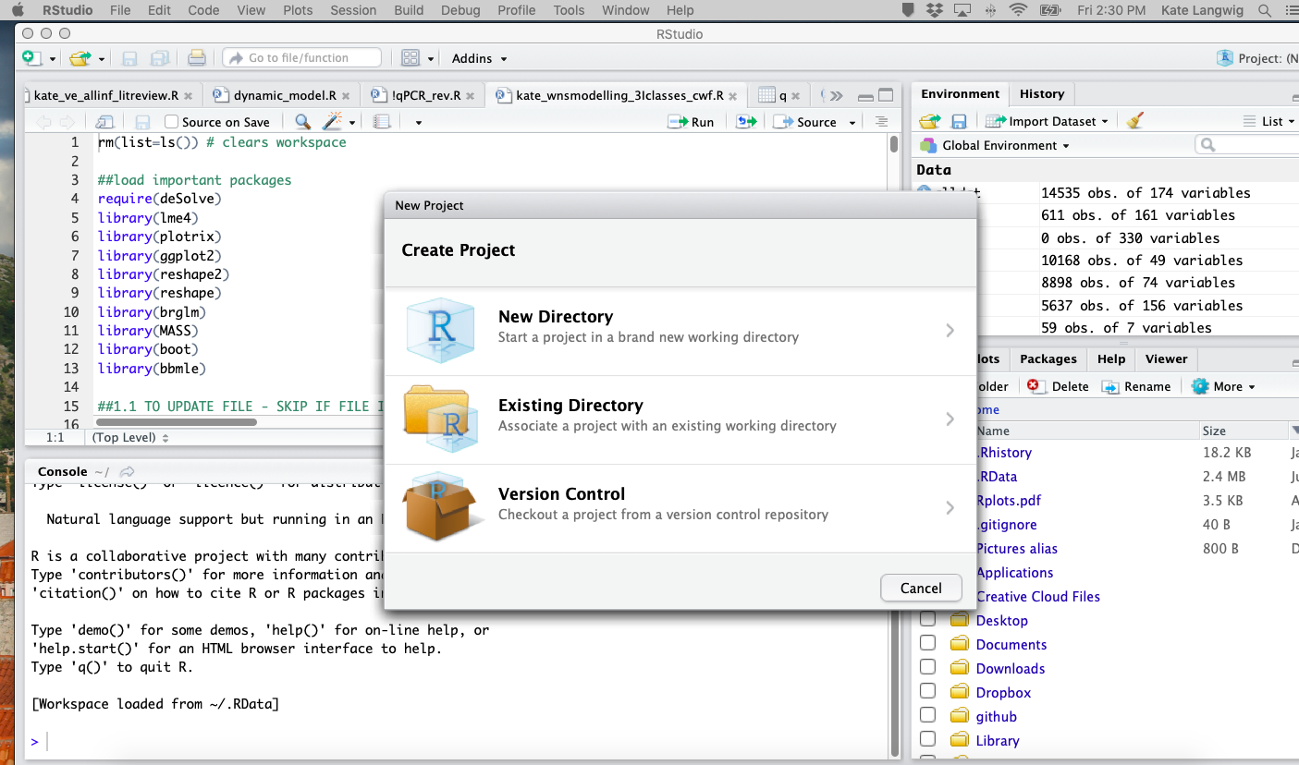
Instructions for creating an R project
File -->New Project
Click either “New Directory” or “Existing Directory” if you already have a named folder. Next week we will create a new project directory for the course that will be compatible with GitHub, but for now, we will demonstrate how to do this on your local computer.
[GO TO R]

Slide 56
Packages to install
Outside of R: xcode (mac only) – see HappyGitWithR
ggplot2
tidyverse
dplyr
reshape2
reshape
gridExtra
Knitr
Load packages with library() – e.g. library(ggplot2)
Can search packages to install using “Packages” tab in lower right, and then clicking “Install” button

